Slide 1

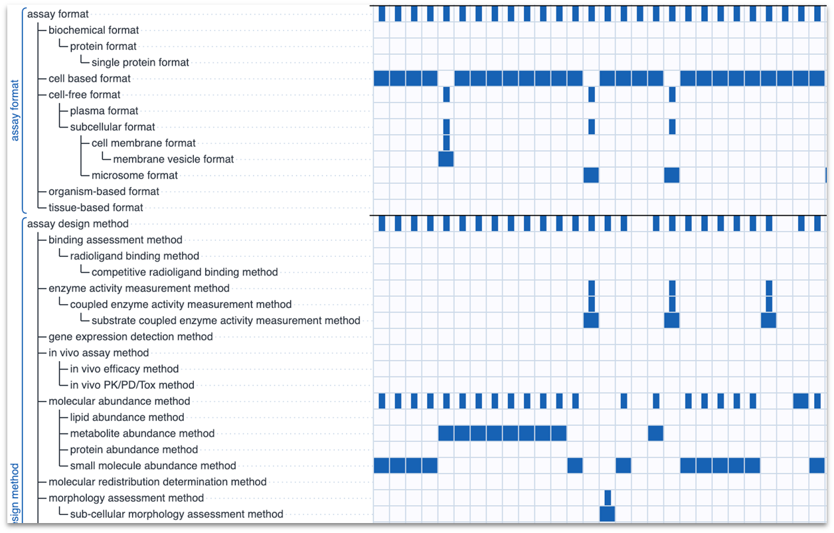
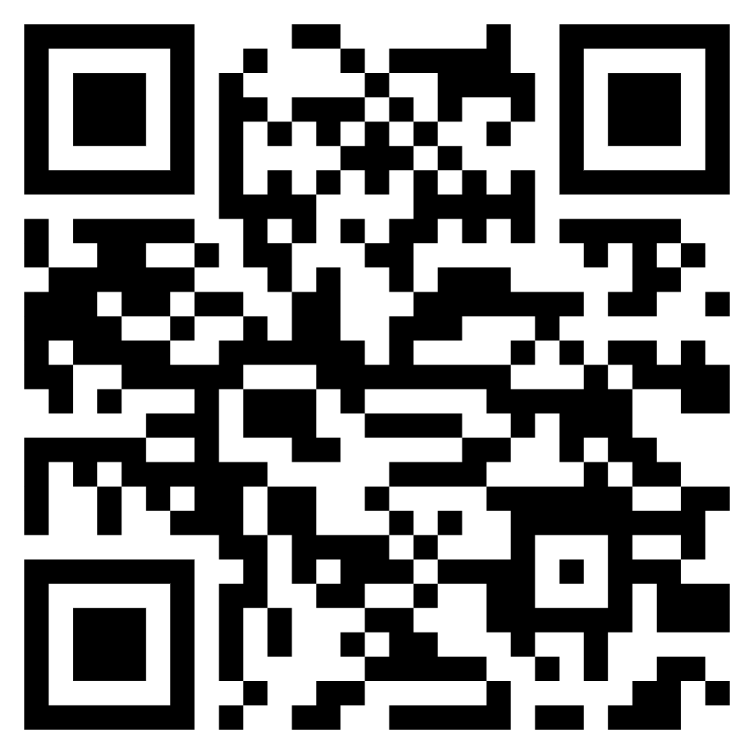
Using ontologies to make bioassay protocols machine readable
Christopher Southan¹, Alex M. Clark² and Barry A. Bunin²
¹ Deanery of Biomedical Sciences, University of Edinburgh, ² Collaborative Drug Discovery, Inc. https://collaborativedrug.com, ORCID IDs: 0000-0001-9580-0446, 0000-0002-3395-4666, 0000-0003-2174-3295
Background
Cheminformatics and bioinformatics have been machine-readable for decades
However, assay informatics is under-developed and reported measurements are rarely FAIR
Public ontologies are standardised and defined but challenging to know how best to use
Development of a Common Assay Template
Needs to encompass most of what we need to know for screening
Example of BioAssay Express built for curation of primary public data
Test-bed for experimental features such as; data entry, searching, analysis, machine learning, text creation and the flexibility of additional options
Common template below (Pistoia Alliance Template is larger and more detailed, see reference at bottom)
Data Curation at Collaborative Drug Discovery
Grant funded: expert curation plus machine learning support
4000 assays from PubChem using Common Assay Template
Pistoia Alliance DataFAIRy project: 2300 detailed assays using Pistoia Alliance Assay Template
Openly available diverse sources including literature, PubChem BioAssay and vendor collections
https://beta.bioassayexpress.com https://github.com/cdd/bioassay-express
Annotation as a product
BioAssay Express: advanced prototype, open source
CDD Vault Annotations, 20% of metadata > 80% value.
Community of Vault users > shared practice
Knowing about the semantic web is optional
Introduce ontologies and templates gently
Well-defined set of terms
Everyone has access to same vocabulary
Minable features display shown on right
Acknowledgments and reference
We would like to acknowledge our esteemed co-authors on the Open-Access paper below
“Bioassay protocol metadata annotation: Proposed standards adoption” SLAS Discov. 2024 Oct 19;29(8):100188. doi: 10.1016/j.slasd.2024.100188. PMID: 39427714
(Link via the QR code on the right)

